Slide 1
B.F. Skinner

Slide 2
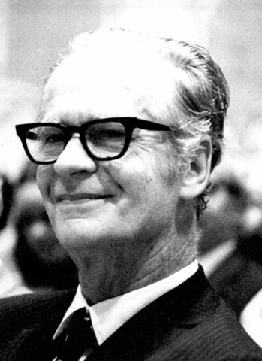
B.F. Skinner
March 20th, 1904
Background
B.A. English Lit.
Hamilton College
Psychology Grad. Program
Harvard
Influences
Watson
Pavlov
Observable Behavior
Notes:
"The consequences of behavior determine the probability that the behavior will occur again" --B. F. Skinner
Video @2:42

Slide 3
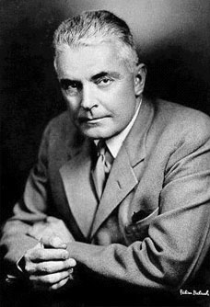
John Broadus Watson
January 9, 1878
Too poor for Medical Degree
Areas of Focus
Comparative Animal Psychology
Behaviorism
Emotional Conditioning
Notes:
“Give me a dozen healthy infants, well-formed, and my own specified world to bring them up in and I’ll guarantee to take any one at random and train him to become any type of specialist I might select—doctor, lawyer, artist, merchant-chief and, yes, even beggar-man and thief, regardless of his talents, penchants, tendencies, abilities, vocations, and race of his ancestors”-J.W.

Slide 4
Watson’s Work
Objectivist
Operationalized behavior
Psychology is a Natural Science
Evolutionary Reactions
(ie. Innate Reflexes)
Environment shapes behavior
Human Conscious
Notes:
[Man] “is an animal different from other animals only in the types of behavior he displays”- J.W.

Slide 5
Operant Conditioning
Thorndike’s Law of Effect
Reinforcement on behaviors
Tested
Response rates to reinforcement
Positive vs. Negative
Fixed vs. Variable
Ratio vs. Interval

Slide 6
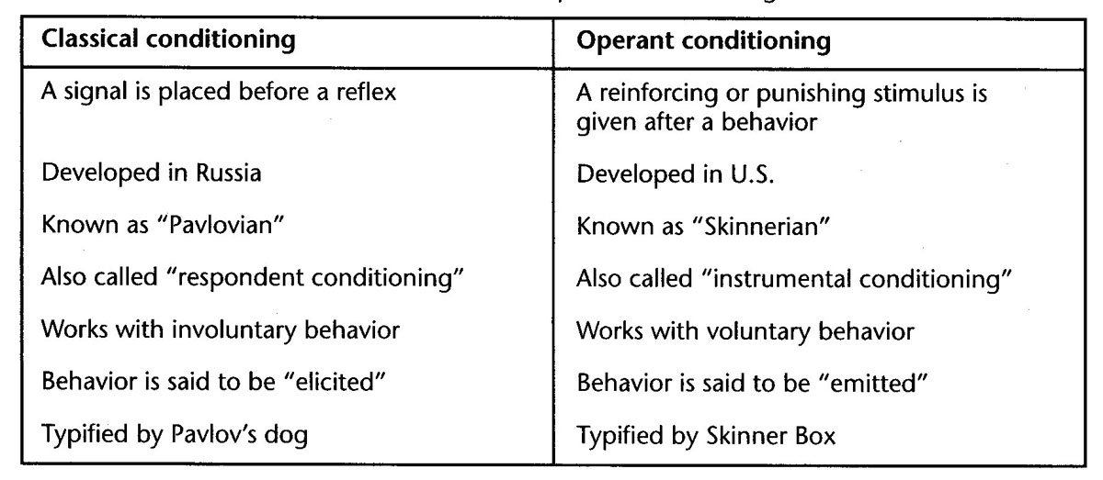

Slide 7
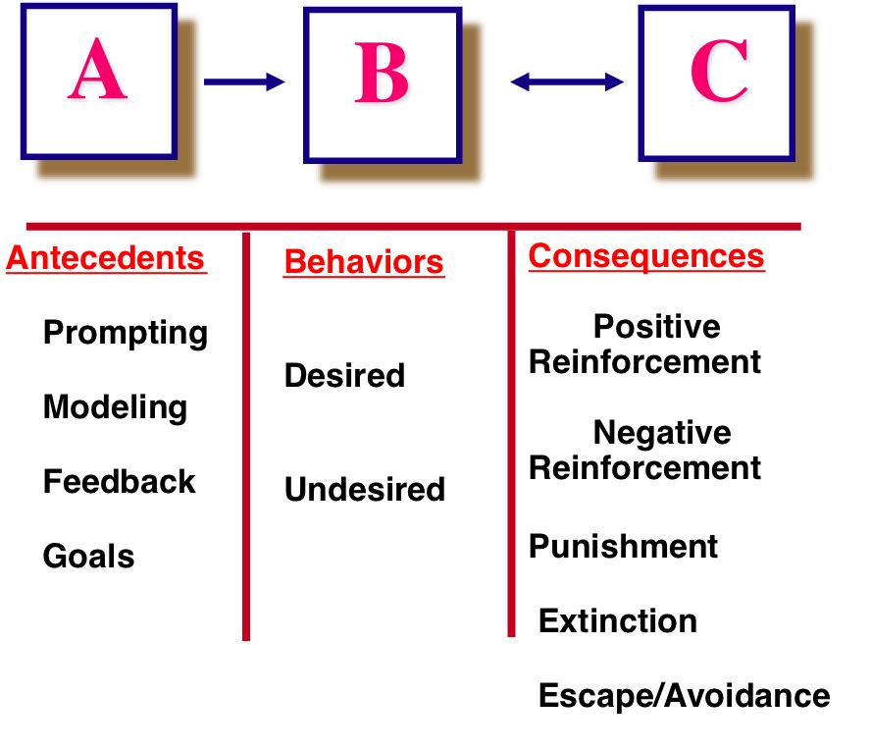

Slide 8
Type | Meaning | Outcome
Fixed Ratio | Reinforcement depends on definite number of responses | Activity slows after reinforcement then picks up
Variable Ratio | # of responses needed for reinforcement varies | Highest reinforcement schedule
Fixed Interval | Reinforcement depends on a fixed time | Activity increases as deadline nears
Variable Interval | Time between reinforcement varies | Stead activity results

Slide 10
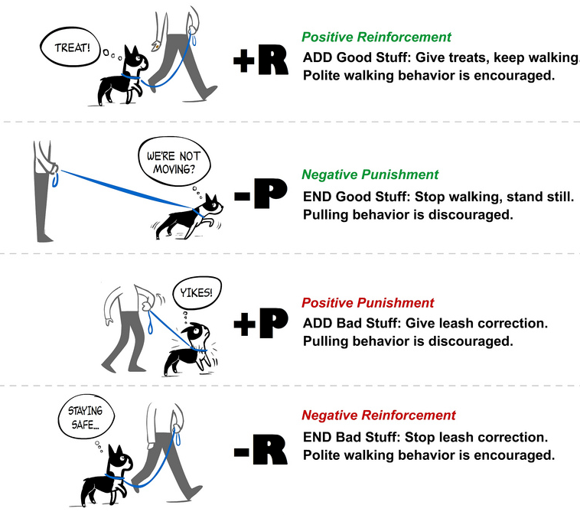

Slide 11
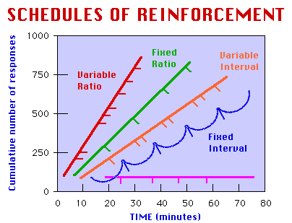

Slide 12
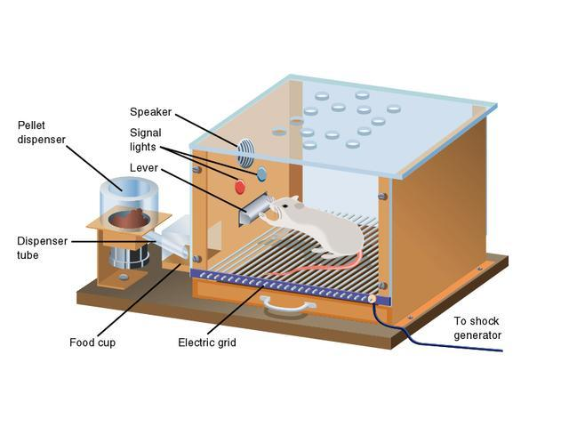
Skinner’s Box

Slide 13
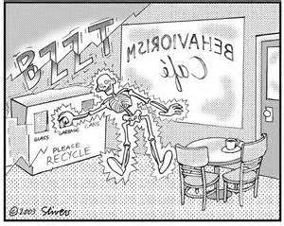

Slide 15
Works Cited
Cherry, K. (2013). About.com. Retrieved 4 21, 2013, from What is the Law of Effect: http://psychology.about.com/od/lindex/g/lawofeffect.htm
Cherry, K. (n.d.). B.F. Skinner Biography. Retrieved 2 1, 2013, from About.com: http://psychology.about.com/od/profilesofmajorthinkers/p/bio_skinner.htm
Culatta, R. (2013). Instructional Design. Retrieved 4 21, 2013, from Operant Conditioning: http://www.instructionaldesign.org/theories/operant-conditioning.html
McLeod, S. (2007). Skinner- Operant Conditioning. Retrieved 2 1, 2013, from Simply Psychology: http://www.simplypsychology.org/operant-conditioning.html
New World Encyclopedia. (2008, 4 4). New World Encyclopedia. Retrieved 4 21, 2013, from B.F. Skinner: http://www.newworldencyclopedia.org/entry/B._F._Skinner
Zimmer, G. (1999). FTR. Retrieved 4 21, 2013, from B.F. Skinner: http://www.sntp.net/behaviorism/skinner.htm
http://www.youtube.com/watch?feature=player_embedded&v=MOgowRy2WC0
http://www.youtube.com/watch?v=yhvaSEJtOV8
http://www.youtube.com/watch?feature=player_embedded&v=YIEt6TrjJXw#!

