Slide 1
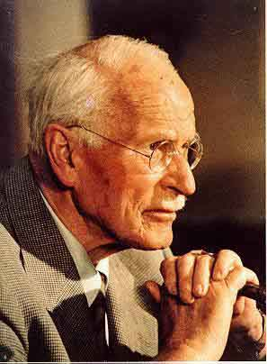
Carl Jung
By: Devone Massey

Slide 2
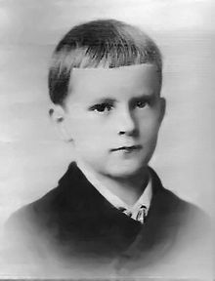
Background Info.
Born: July 26,1875
Died: June 6, 1961
Kesswil, Switzerland
Parents:
Paul Jung and Emilie Preiswerk
Fourth Child
Introverted and solitary child
At age 12 parents thought he had epilepsy = first encounter with neurosis
Notes:
Fourth child but only surviving. Mother was always depressed and would sometimes disappear from home up until they moved closer to her parents. Rather be left alone with his thoughts. Lost consciousness at age 12 in school (pushed by a kid). Started fainting when it came time to go to school or do homework. Neurosis = a mental and emotional disorder that affects only part of the personality, is accompanied by a less distorted perception of reality than in a psychosis, does not result in disturbance of the use of language, and is accompanied by various physical, physiological, and mental disturbances (as visceral symptoms, anxieties, or phobias)

Slide 3
Career
Attended Basel’s University
Studied medicine, psychiatry, philosophy, and theology
Moved to Zurich in 1900 to work with Eugen Bleuler in a psychiatric hospital
Influenced by Freud
Developed fascination with unconscious mind
Rejected Freud
Formed Analytical Psychology (Jungian Psychology)
Notes:
Mainly examined patients, takes care of them, and keeping medical histories. Later rejected Freud’s theory because Freud believed sex was the sole source of behavior motivation. Analytical psychology is a form of analysis in which the emphasis of the treatment process is on strengthening the individual's connection to, and consciousness of, the creative and healing elements as well as destructive potentials within the psyche.

Slide 4
Contributions to Psychology
Divided psyche into 3 parts: ego, personal unconsciousness, and collective unconsciousness
Ego: also known as conscious mind
Personal Unconsciousness: Stores unique personal experiences and memories (may not be consciously remembered)
Collective Unconsciousness: contains memories and behavioral predispositions (inherited)
Notes:
Ego: executive of the individual; involved in making decisions, learning, growing and obtaining wisdom
Personal Unconscious: Describes anything that can be brought to the conscious mind with ease, but isn’t presently, including impulses, fears, traumas and memories. Included in this category are memories that have been suppressed or forgotten, or are too weak to reach the conscious mind.
Collective Unconscious: Jung’s theory of the collective unconscious is often described as the ‘driving inheritance’ or ‘psychic inheritance’. This part of the psyche is never consciously called upon, but directs a person’s emotional reactions. It is a collection of the religious, spiritual and mythological symbols which are passed down through the generations and therefore pre-date the individual.

Slide 5
Contributions to Psychology
Individuation = process in which various parts of a person become completely integrated so that the individual become his or her “true self”
Includes conscious and unconscious
Synchronicity = meaningful coincidence in time of two or more similar or identical events that are casually unrelated
Gave evidence for his concepts of archetypes and collective unconscious
Notes:
"In general, it is the process by which individual beings are formed and differentiated [from other human beings]," explained in Psychological Types. "In particular, it is the development of the psychological individual as a being distinct from the general, collective psychology."

Slide 6
Works
“On the Psychology and Pathology of So-Called Occult Phenomena” – Dissertation
Published works and articles in psychiatry
Published “The Psychology of Dementia Praecox” in 1907
“Psychology of Unconscious” (1912)
“Psychological Types” (1921)
Notes:
Mainly about newly invented test of word associations, such as Studies in Word Association, & Collected Papers on Analytical Psychology.
1907 works sent to Freud

Slide 7
References
http://www.merriam-webster.com/dictionary/neurosis
http://www.carl-g-jung.de/english/carljung.html
http://psychology.about.com/od/profilesofmajorthinkers/p/jungprofile.htm
http://www.thefreedictionary.com/synchronicity
https://www.youtube.com/watch?v=y66F58fbNxk
https://www.youtube.com/watch?v=BX_nMwYa-nw
http://counsellingcentral.com/carl-jung-the-psyche-or-ego-personal-unconscious-and-collective-unconscious/
http://www.junginla.org/institute/analytical_psychology

