Slide 1
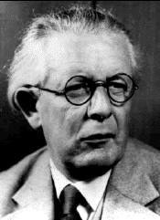
Jean Piaget(1896-1980)
Brennan O’Connor
Dr. Fernandes
4/28/13

Slide 2
Piaget’s Begginning
Born in Neuchatel, Switzerland
Was devoted to the studies of biology and zoology
Published many articles mostly about systematic zooology

Slide 3
Piaget’s Beginning Cont.
1918 awarded a doctorate of natural sciences from the University of Neuchatel for thesis on mollusks
Authored the essay “Biology and War” in the same year
Was an attack on instinctual explanations of war and on individualism, favored socialism

Slide 4
Psychology
After getting his doctorate he studied experimental psychology and psychopathology at Zurich
Trained with Theodore Lipps, Eugen Bleuler, and Carl Jung then with Alfred Binet
Studied writings of Lucien Levy-Bruhl on the cognitive abilities of “primitive” people
Built the thesis of “prelogical mentality” into his studies of children’s cognitive abilities

Slide 5
New Ideas
Wrote his first psychology article titled “Relationship between Psychoanalysis and Child Psychology” in 1920
Two decades later had published six major books on such broad developmental topics
Language, intelligence, moral judgment, reasoning, causality, and the construction of reality in children

Slide 6
Children interaction
Conducted extensive interviews with children rather than administer the tests in a standardized manner which proved insightful
Led to development of general theory of genetic epistemology which stressed the activation of schemas within serially progressive stages
Stated that cognition develops in sequence from sensory-motor to abstract reasoning

Slide 7
Genetic epistemologist
Would be remembered as such
Spent 30 years on child psychology rather than the five he planned on
Research was guided by the quest for the psychogenesis of cognition

Slide 8
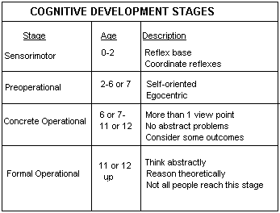
Piaget Cognitive Development

Slide 9
Piaget Cognitive Development Contributions
Used naturalistic observation and clinical interviews and studies
Changed how the world viewed child development
His ideas have had practical use in the education of children

Slide 10
Contributions cont.
Assimilation and accommodation showed a correlation between how children add new information to what they already know
Schemas were his building blocks of life that were assimilated and accommodated
The stages of development we use even today paired along the side of Erik Erikson’s work which was influenced by Piaget

